Slide 1
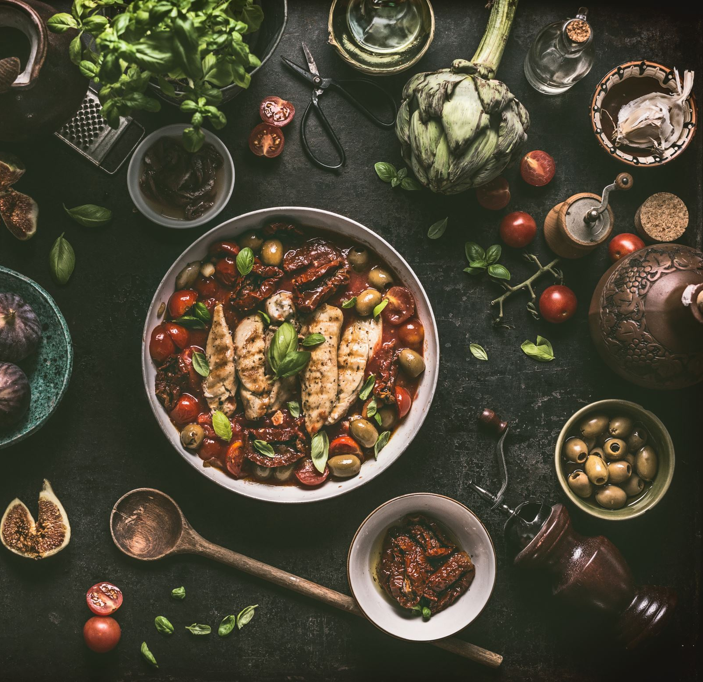
One (Healthy) Recipe to Rule them All
Group 4
Alyssa Hondrade
Lakna Premasinghe

Slide 2
Scope
Background
Data Exploration and Cleaning
Data Analysis and Visualisation
Conclusion

Slide 3
Background
2020-2021 National Healthy Survey (NHS):
94% of Australian adults do not meet the recommendations for daily fruit and vegetable consumption.
12% of do not eat any fruit.
1.6% of do not eat any vegetables.

Slide 4
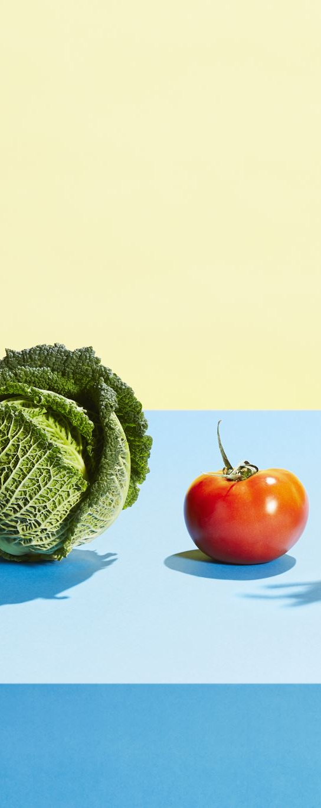
Background
94% of Australian adults do not meet the daily recommendations for fruit and vegetable consumption.
Notes:
Our group was interested in a topic in the healthcare field, with an application that is easily relatable and one that would not require too much research understanding the context, given the project time constraints.
We landed on the idea of nutrition and food, because who doesn’t love to eat delicious food?
We explored Australian nutrition and discovered that according to the 2021 National Health Survey, 94% of Australian adults do not meet the daily recommendations for fruit and vegetable consumption.
The goal of the project is to compare recipes from two popular recipe websites, Spoonacular and Food.com, and identify “healthy” recipes using two market-implemented measures: Nutri-Scores and Weight Watchers Smart Points.

Slide 5
Research Questions
Popularity vs Health Rating
Are more popular recipes healthier?
What is the health rating of the most popular recipes?
Meal Types
What meal type (breakfast, lunch, or dinner) is the healthiest?
What percentage of recipes are healthy?
What is the most popular ingredient per meal type?
Cuisines: Which cuisine has the healthiest recipes?

Slide 6
Background
Breakfast
Lunch
Dinner
Meal Type
Notes:
Our group was interested in a topic in the healthcare field, with an application that is easily relatable and one that would not require too much research understanding the context, given the project time constraints.
We landed on the idea of nutrition and food, because who doesn’t love to eat delicious food?
We explored Australian nutrition and discovered that according to the 2021 National Health Survey, 94% of Australian adults do not meet the daily recommendations for fruit and vegetable consumption.
The goal of the project is to compare recipes from two popular recipe websites, Spoonacular and Food.com, and identify “healthy” recipes using two market-implemented measures: Nutri-Scores and Weight Watchers Smart Points.

Slide 7
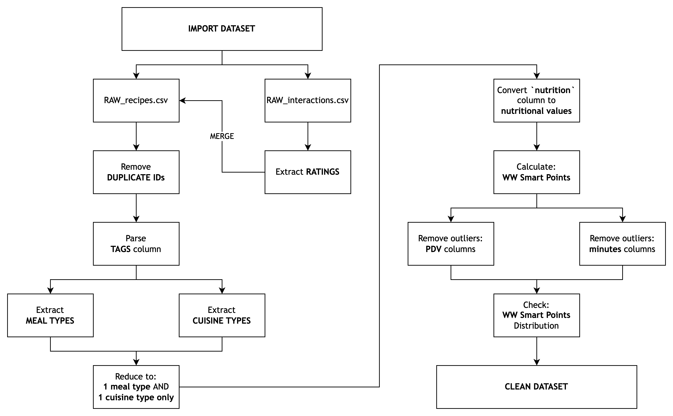
Data Exploration and Cleaning

Slide 8
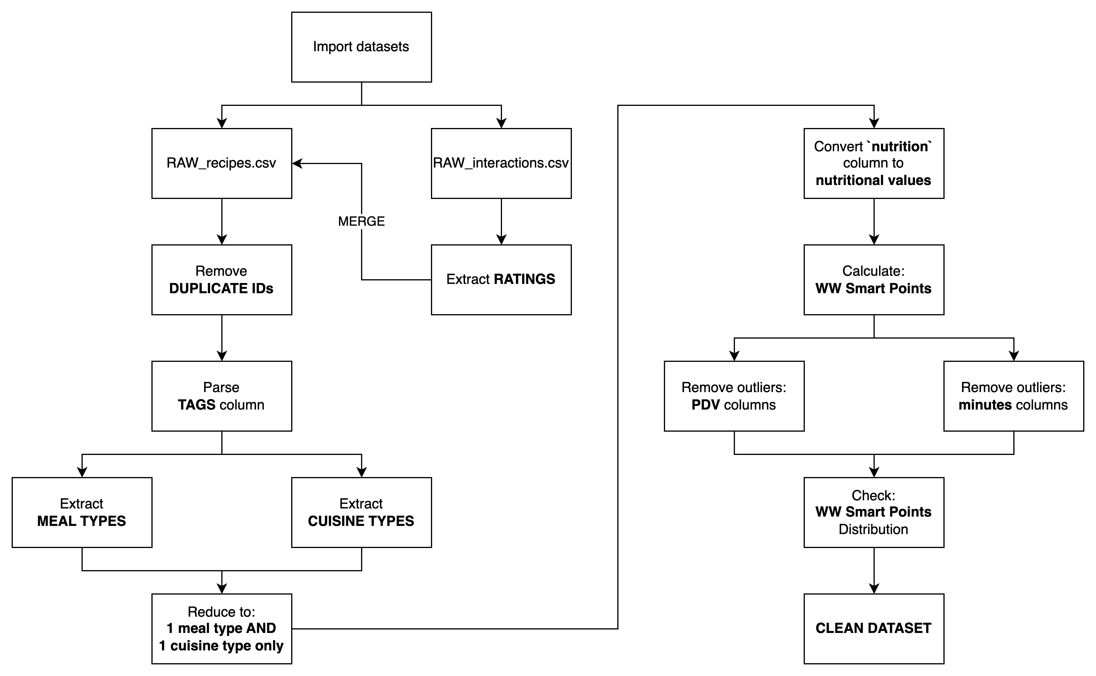
Data Exploration and Cleaning
(Insert image of the flowcharts)
Before opening the notebook, discuss the main dataset is based on Food.com

Slide 9
Data Analysis and Visualisation

